Slide 1
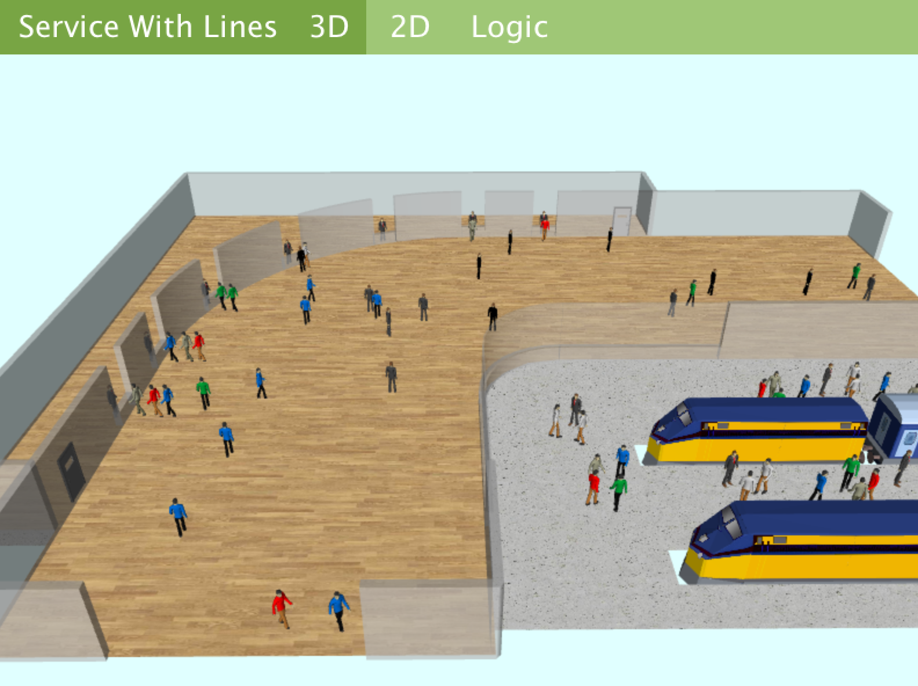
Simulation - Pedestrian library
Dr. Xueping Li

Slide 2
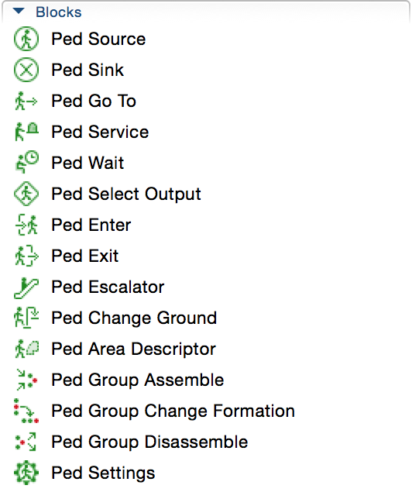
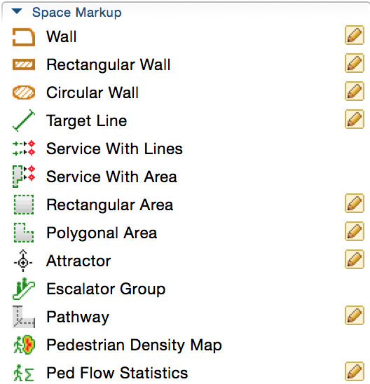

Slide 3
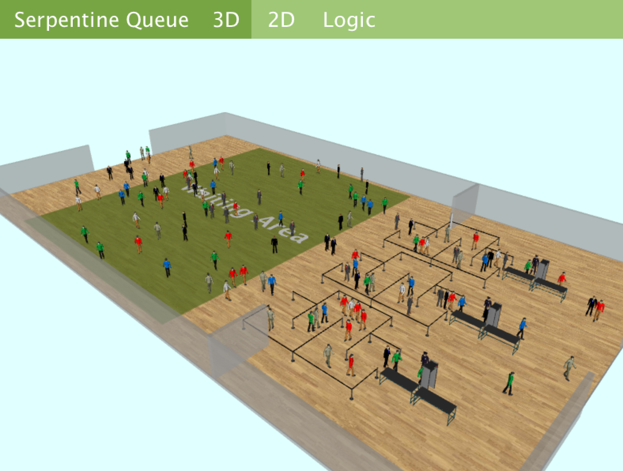
Serpentine Queue

Slide 4
Service with Lines

Slide 5
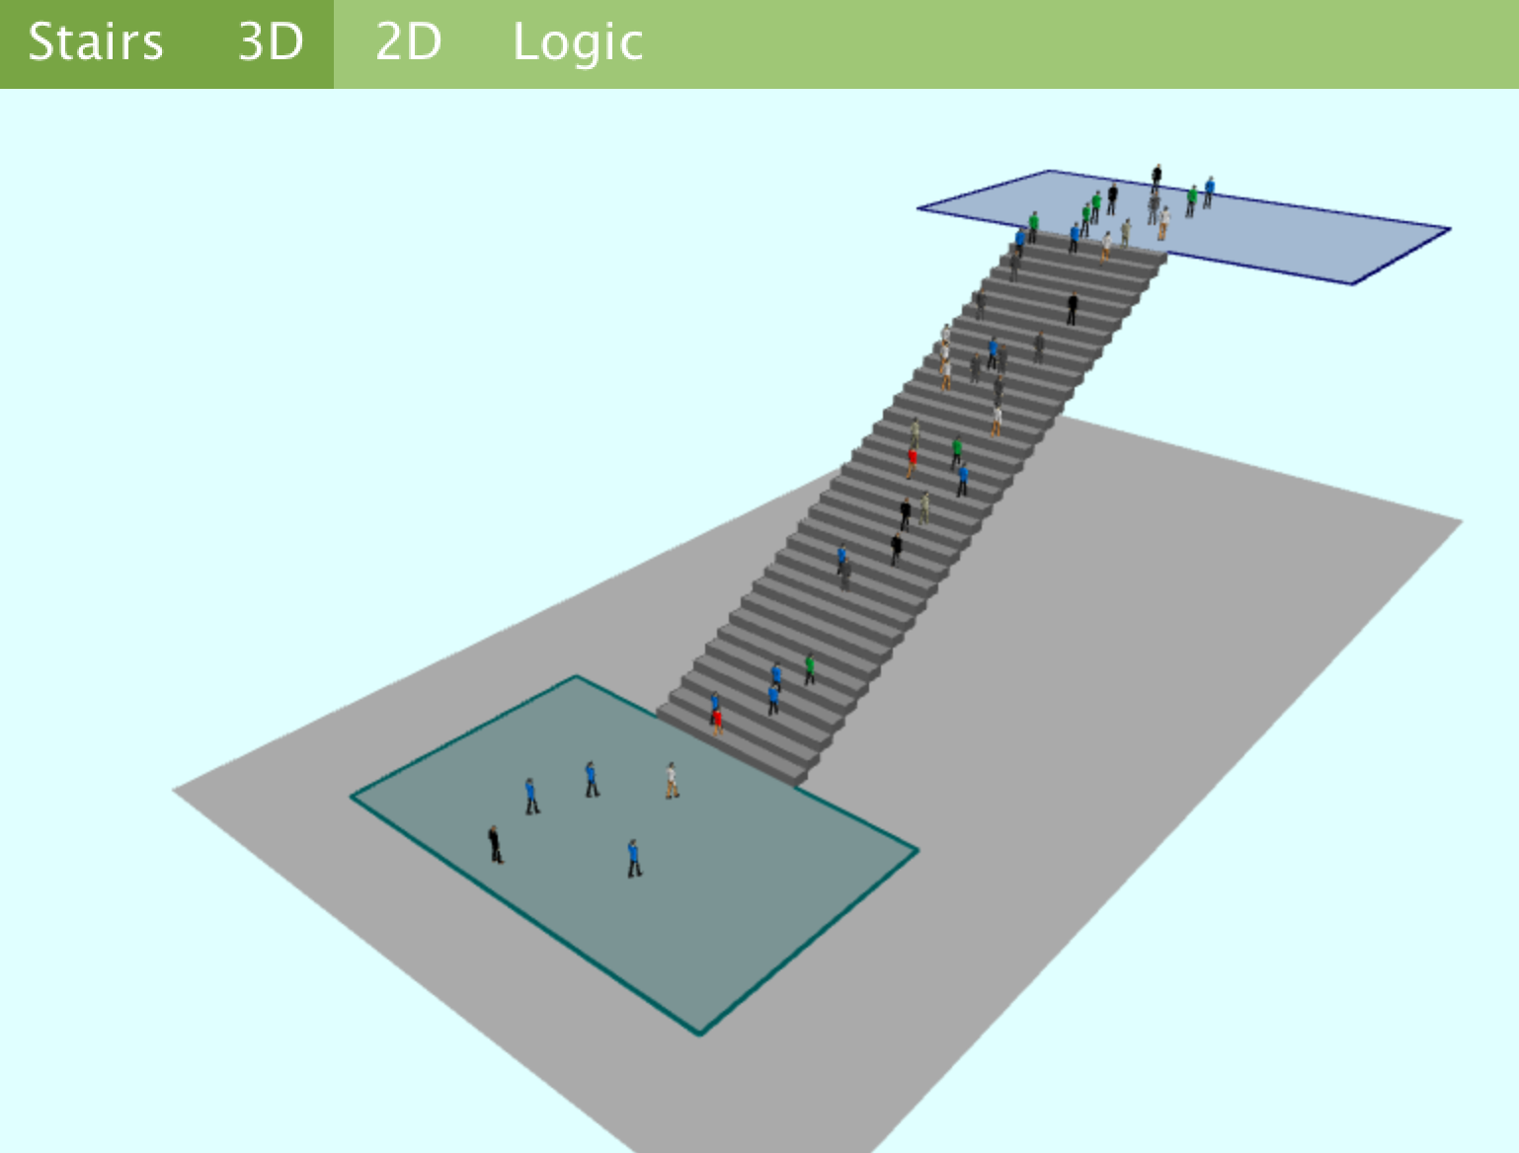
Stairs

Slide 6
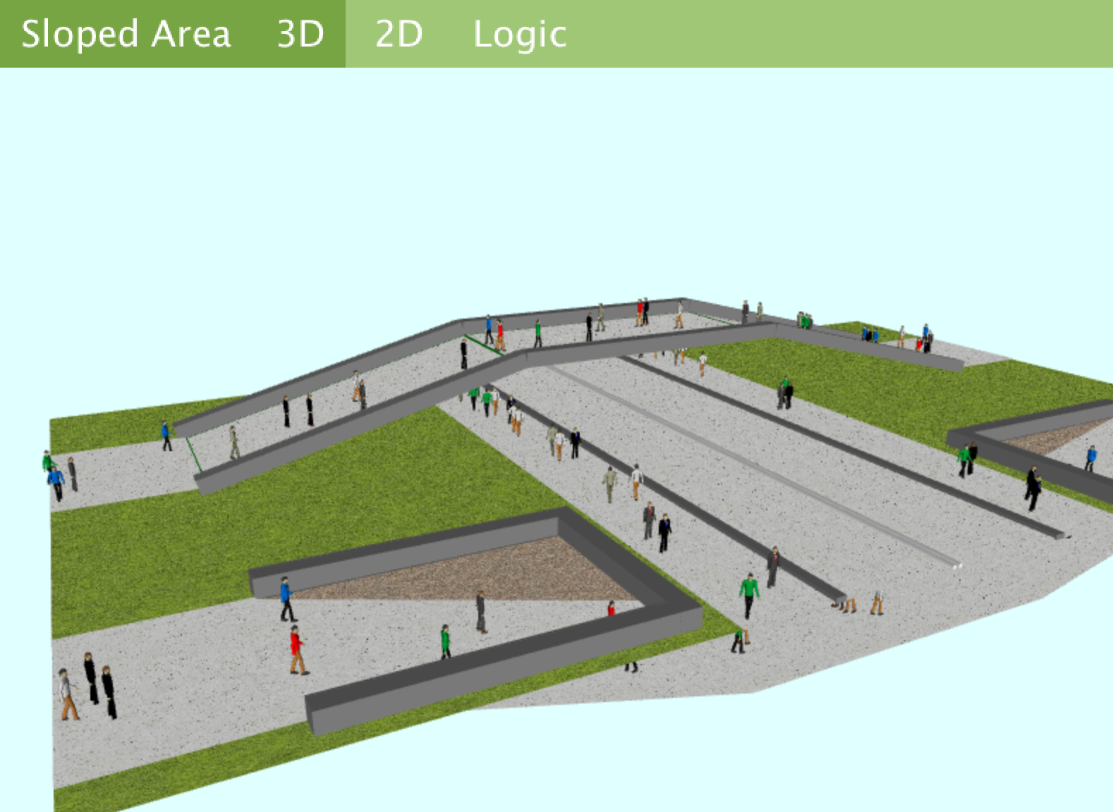
Sloped Area

Slide 7
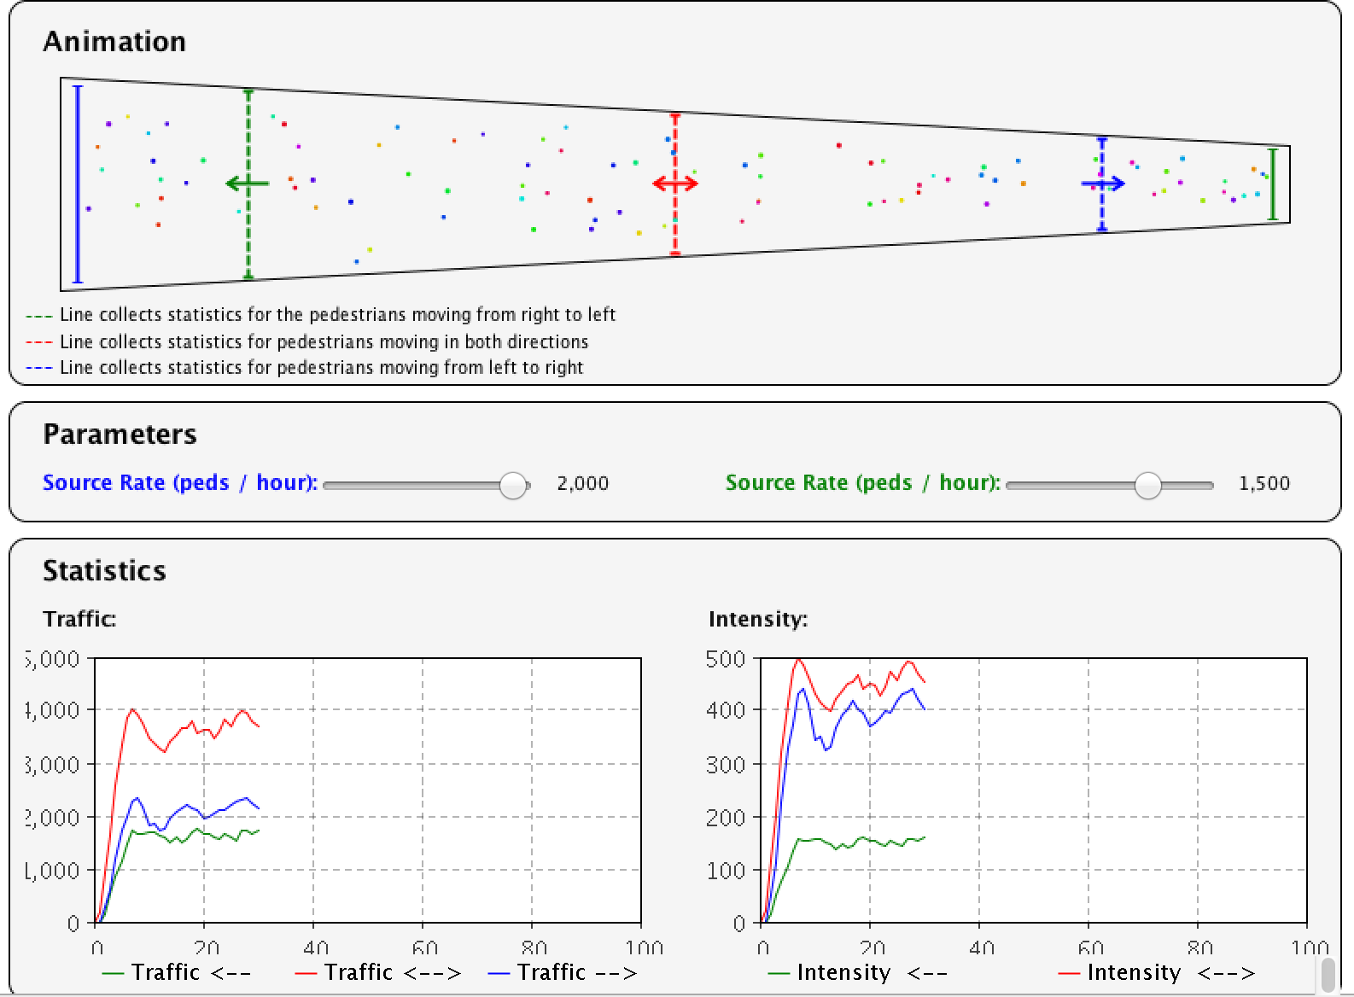
Flow Statistics

Slide 8
HOWTO

Slide 9
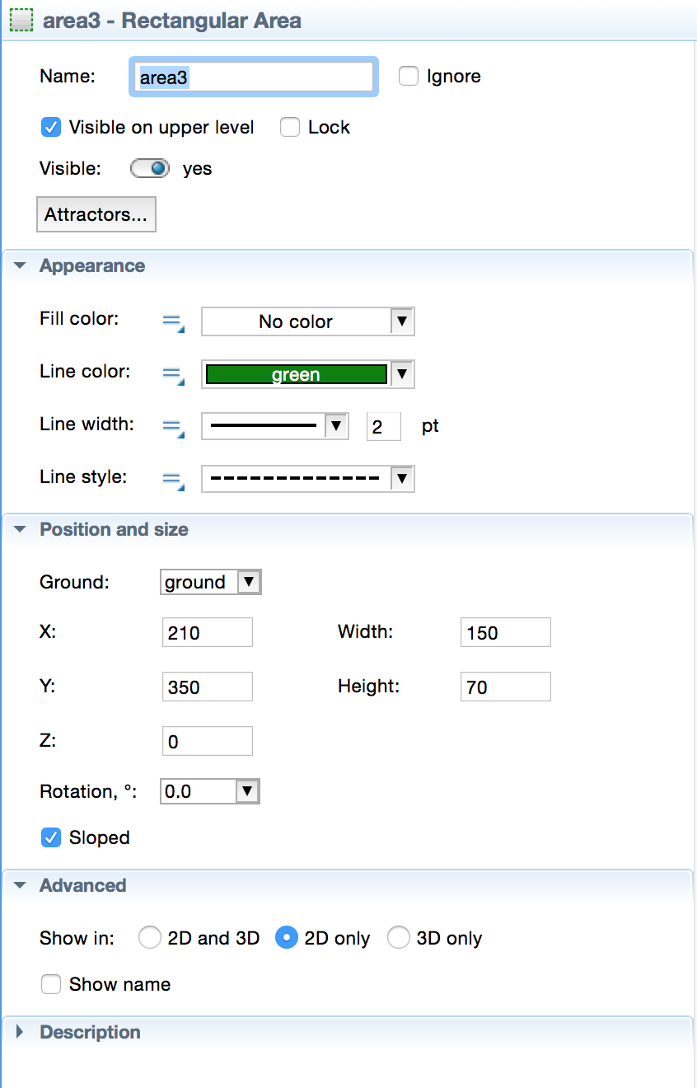
How to make a slope?
See the Sloped checkbox!

Slide 10
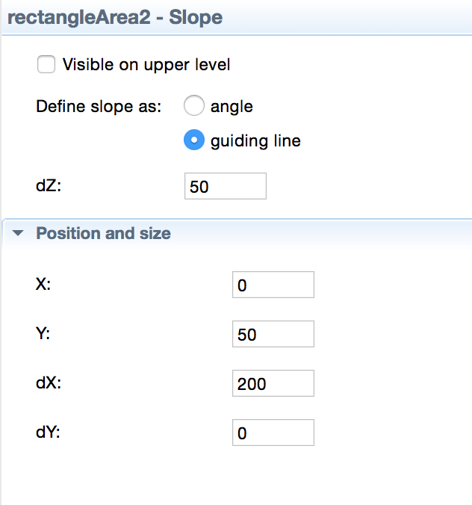
Now you can use “Angle” or “Guiding line”
Tip:
Use a negative number to slope down …
And rotate the slope if needed.

Slide 11
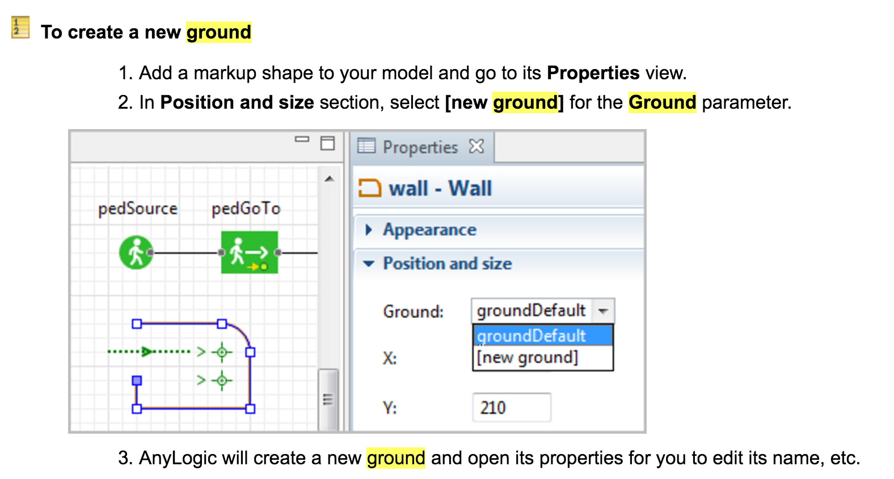
Create a new Ground

Slide 12
Another way to create a ground??
Simply copy the default one and rename it!
Remove old shape and create new ones as needed~

Slide 13
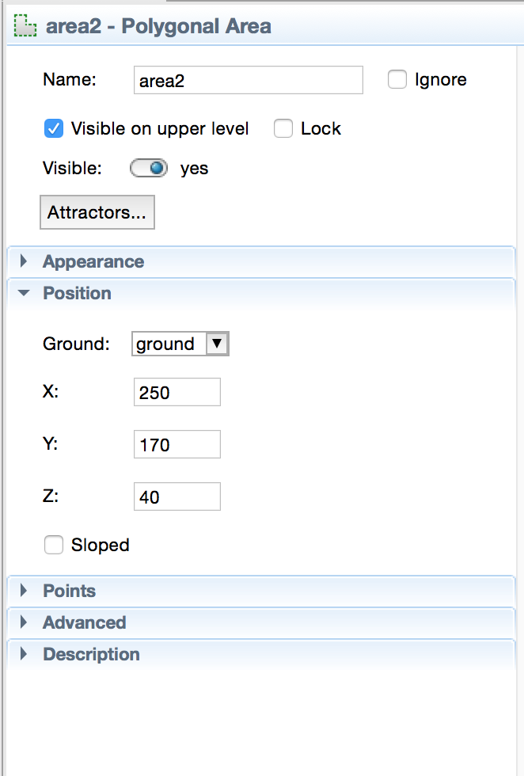
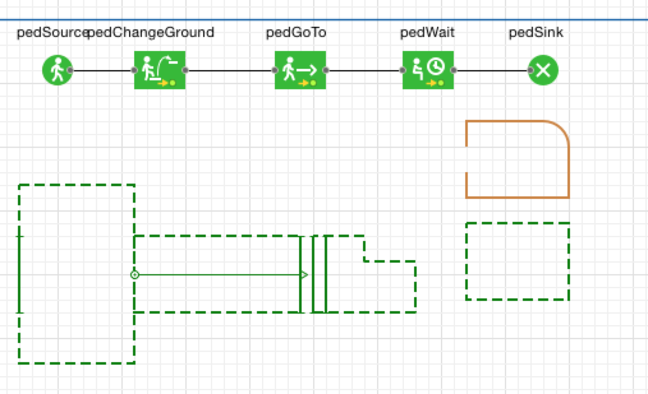
Change Ground??
Tips::
Change Z value
Exit and enter lines

